Slide 1
Price Levels and Price List

Slide 2
Price Levels and Price List
In Tally prime, you can create different Price Levels and assign different Price Lists to these Price Levels. For example, you can create Wholesaler, Distributor and Customer as Price Levels and assign applicable Price Lists to these Price levels, as per your requirements, so that only the relevant prices and discount rates are used during entry of orders and invoices. Before you start creating Price Lists, you may decide to create Price Levels as required.

Slide 3
Enabling in Tally prime
Select F11 Features Inventory
Enable multiple price levels-yes
Use separate discount column in invoices-Yes
Create Inventory masters Price Levels:
Wholesale
Retail sale
Export Sale

Slide 4

Fixing Price List
create Inventory Masters Price List

Slide 5
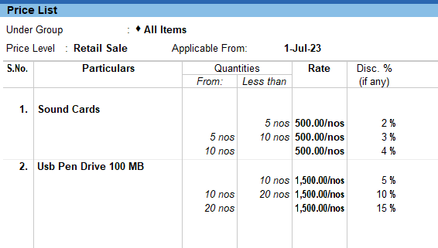
Cont…

Slide 6
Secnario-1
On 1St of July Abc Pvt Ltd made a Retail sale to Beltron Computers by fixing a price list for the following Items.
Solution:
Goto Accounting Vouchers Sales Voucher(F8)
(Item Invoice)
Name of the Item | Quantity | Rate | Discount
USB Pen Drives 100MB | 30 Nos | 1500 | 15%
Sound Card | 10 Nos | 500 | 4%

Slide 7
Q&A

